Slide 1
Python API: Basics
1. TiGL Workshop, September 11 / 12, Cologne
Martin Siggel
German Aerospace Center

Slide 2


Outline
Motivation: Why a new low-level Python API?
Installation
Design and architecture
CPACS tree traversal with the tigl3.configuration module
Geometric components and named shapes
File exports with tigl3.exports
Practical session

Slide 3
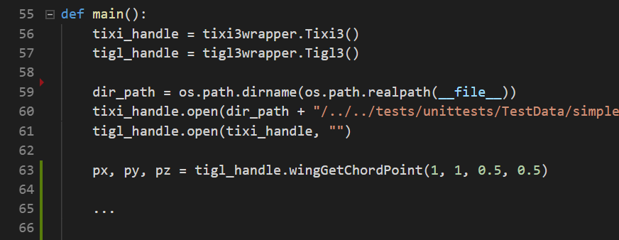
Motivation The old “high-level” API
Wraps the TiGL C API to Python
Used for many years by most of our users
Pros:
Very easy to use
Hides internal complexity of TiGL
Cons:
Can do only what developers intended
Very limited functionality
No direct interaction with geometries
Can be slow
We need a way, to access TiGL’s internals

Slide 4
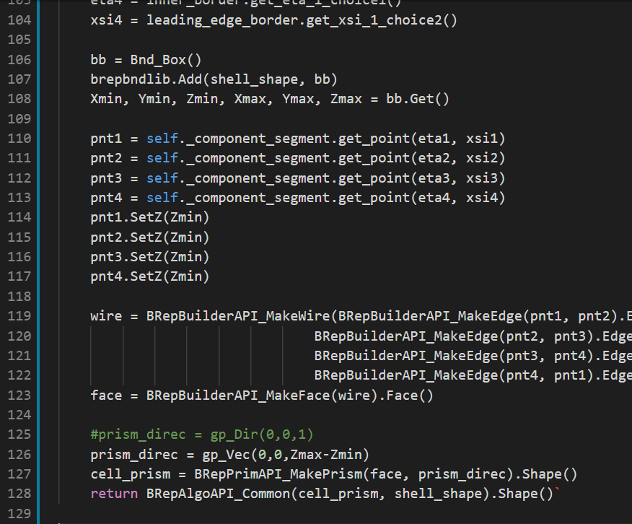
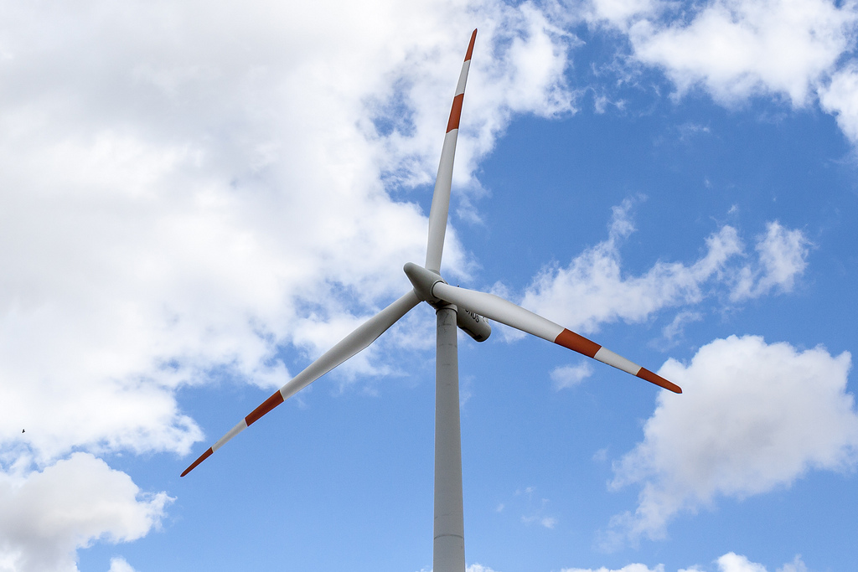
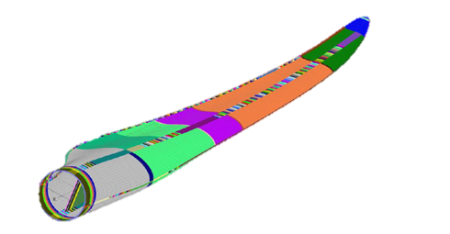
Motivation An example
Problem:
Colleagues wanted to create wing cell geometries with different materials for FEM simulations of wind wheels
Wing cells not modelled in TiGL
Solution:
They used TiGL low-level python API with pythonOCC
They created their own cell geometry code

Slide 5
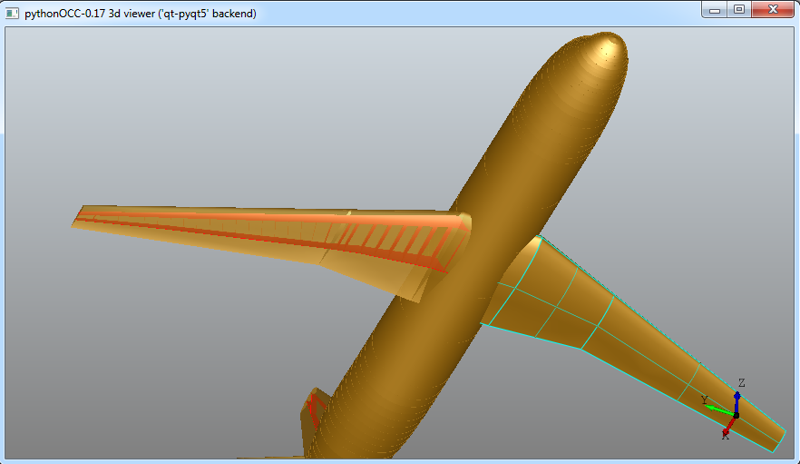
The Low-Level Python API
Why?
We want to give you a flexible tool to be creative
You are the experts: You should build your own models!
What do you get?
Fast object-oriented access to all TiGL’s internals without compilation
Full interoperability with OpenCASCADE (pythonOCC)
Flexibility
New geometry operations like Gordon surfaces
Customizable file exports and imports
Visualization with only a few code lines
Create meshes using GMesh or SMesh
What do we get?
We can focus on internals and algorithms
Maybe more feedback or even contributions
Created with low-level API. ~50 lines of code

Slide 6

Installation Conda
Conda: „Package, dependency and environment management for any language—Python, R, Ruby, Lua, Scala, Java, JavaScript, C/ C++, FORTRAN”
De-facto standard in scientific community
Differences to PIP:
Packaging also non-Python packages like libraries, executables …
Support for compiled binary packages
Custom package repositories
Common to PIP:
Virtual environments
Large package repositories
Update of packages
TiGL’s Conda repository: https://anaconda.org/DLR-SC/

Slide 7
Installation Conda
1. Install TiGL 3 into new virtual environment „tigl_env“ using python 3.5:
2. Switch into tigl_env environment:
3. There, install other packages or run python interpreter, e.g.:
>> conda create -n tigl_env tigl3 python=3.5 –c dlr-sc
>> activate tigl_env
(windows)
>> source activate tigl_env
(mac/linux)
>> conda install numpy matplotlib

Slide 8
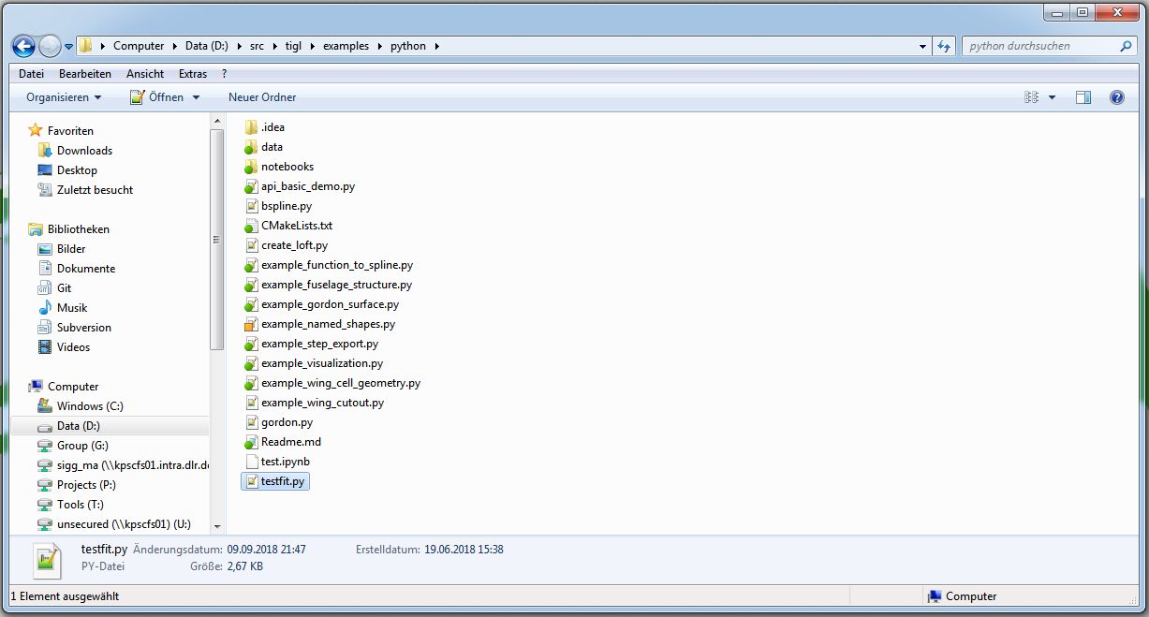
Getting started
Have a look at the examples/python directory of TiGL!

Slide 9
Design philosophy
Direct unaltered access to the internal C++ API
Gives the same possibilities as if you were using the C++ interface
Full interoperability with OpenCASCADE
Provide additional wrapper functions to make use more pythonic
Small drawback: C++ API is not stable and sometimes changes (a bit)

Slide 10

Architecture
OpenCASCADE bindings pythonOCC generated with SWIG software: http://www.swig.org/
TiGL low-level API also generated with SWIG from TiGL and pythonOCC
Objects between pythonOCC and TiGL can be exchanged
Input files for Swig can be found in: <TiGL-Source>/bindings/python_internal
SWIG can also generate bindings for other languages!
Small drawback: Bindings must be compiled for specific platform and python version!
TiGL low-level Python API
TiGL hi-level Python API
via Swig
via ctypes
pythonOCC
TiGL
via Swig
native
OpenCASCADE CAD Kernel
TiXI

Slide 11
Internal Structure
Low-Level API consists of the following modules:
Module | Description
tigl3.configuration | Access to the whole cpacs tree including wings, fuselages …
tigl3.geometry | Functions related to geometry operations, e.g. curve interpolation
tigl3.curve_factories | Functions to create curves based on tigl3.geometry
tigl3.surface_factories | Functions to create surfaces based on tigl3.geometry
tigl3.occ_helpers | Pythonic wrappers to OpenCASCADE functions
tigl3.exports | File export classes
tigl3.imports | File import classes
tigl3.boolean_ops | Classes to perform Boolean operations
tigl3.tmath | A few math functions
tigl3.core | Core functionality, like error handling

Slide 12
The tigl3.configuration module CPACS tree traversal
TiGL handles several aircraft configurations at a time. To get a specific one, use the configuration manager class:
Load the „old“ high-level python API
Retrieve the global CCPACSConfigurationManager object
Access a specific aircraft config, given by it‘s TiGL handle (integer value)
aircraft_config is instance of class CCPACSConfiguration. Gives direct access to fuselages, wings, systems …
from tigl3 import tigl3wrapper
from tigl3.configuration import CCPACSConfigurationManager_get_instance
tigl_handle = tigl3wrapper.Tigl3()
tigl_handle.open(tixi_handle, "")
mgr = CCPACSConfigurationManager_get_instance()
aircraft_config = mgr.get_configuration(tigl_handle._handle.value)
0
1
2
0
1
2

Slide 13
The tigl3.configuration module CPACS tree traversal
Use help to look for the available methods and members of each CPACS node
help(aircraft_config)
Examples:
wing = aircraft_config.get_wing(1)
wing = aircraft_config.get_wing("wing_uid")
wing.get_uid()
segment = wing.get_segment(2)
segment = wing.get_segment("segment_uid")
aircraft_config.get_fuselage(1)
aircraft_config.get_uid()
Access wing spar properties:
aircraft_config.get_wing(1).get_component_segment(1).get_structure().get_spar_segment(1) .get_spar_cross_section().get_rotation()
This way, accessing a specific object can be lengthy!

Slide 14
The tigl3.configuration module UID Manager
Most objects that have a CPACS uid are registered at the UID manager when reading the CPACS file
The UID Manager is a member of the CCPACSConfiguration object
The UID Manager enables direct access to those objects:
uid_mgr = aircraft_config.get_uidmanager() wing = uid_mgr.get_geometric_component("WingUID")
spars = uid_mgr.get_geometric_component("SparSegmentsUID")
…
Caveat: From Python only geometric components can be queried at the moment

Slide 15
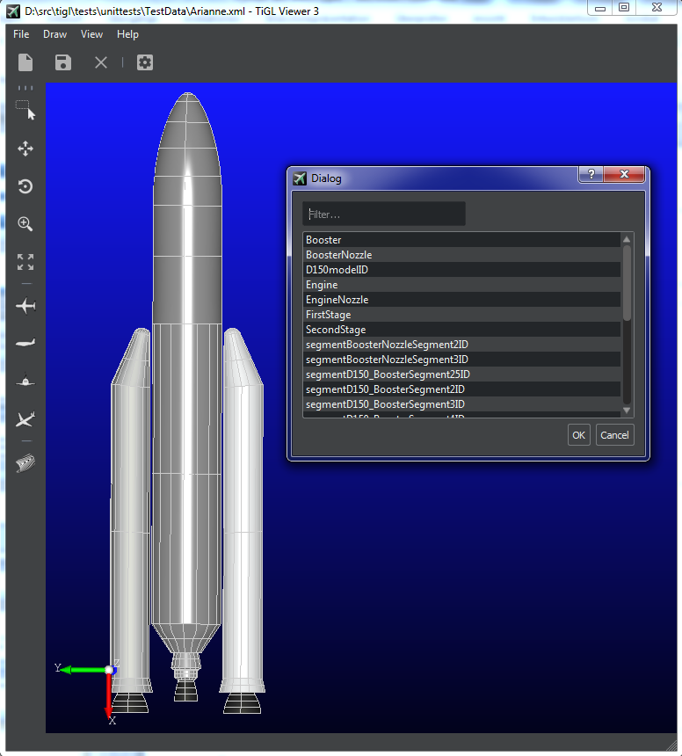
The tigl3.configuration module Geometric components
Cpacs nodes that have a geometry are a geometric component and derived from class ITiglGeometricComponent
To look, which geometric components currently are supported:
Open TiGL Viewer
Menu → Draw → Aircraft → Draw any component
These are today:
Wings, Wing Segments, Fuselages, Fuselage Segments, Component Segments, Wing Cells, Wing Spars, Wing Ribs, Wing Chord Face, Wing Upper/Lower Side, External Components, Systems, Rotors, Rotor Blades, Fuselage Cross Beams, Fuselage Cross Beam Struts, Long Floors, Pressure Bulkheads, Doors
Access the geometry of geometric componenent with get_loft() method:
wing.get_loft()

Slide 16
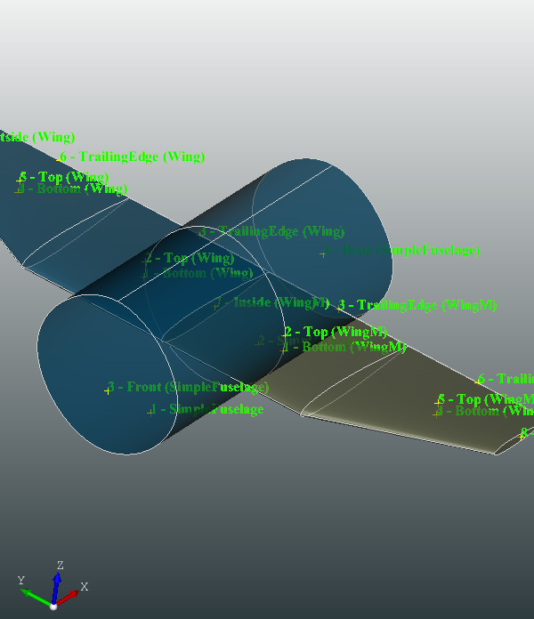
Named Shapes Shapes with metadata
component.get_loft() returns an instance of tigl3.geometry.CNamedShape
Contains additional metadata next to the raw shape
Is used by the TiGL exports to write also identifiers and names
Allows to track the history of shape creation and modification, in particular after Boolean operations
Contains a graph of the shape creation history

Slide 17
Named Shapes Shapes with metadata
Methods of tigl3.geometry.CNamedShape object are:
.shape(): The actual shape as used by OpenCASCADE (OCC.TopoDS.TopoDS_Shape)
.name(): The name of the shape (string)
.short_name(): A short name of the shape (used for IGES identifiers)
.get_face_traits(i): properties of the i-th face, including:
.name(): Name of the face
.set_name(): Set the name of the face
.origin(): Shape from which the face was originally created from (CNamedShape)

Slide 18
Named Shapes Creation and modification
Build from an OpenCASCADE shape, e.g.
from tigl3.geometry import CNamedShape
box = BRepPrimAPI_MakeBox(0.5, 0.5, 0.5).Shape() # Build a box with OpenCASCADE
box_ns = CNamedShape(box, "MyBoxObj")
Get number of faces of the box
print(box_ns.get_face_count()) # Should be 6
Print current name of the 4-th face
print(box_ns.get_face_traits(4).name())
Modify the name of the 4-th face
box_ns.get_face_traits(4).set_name("bottom")

Slide 19
The tigl3.export module
File exports are interfaces to simulation software or CAD programs
The tigl3.export module includes exports for the following file formats
Format | Description
Step (ISO 10303) | Current industry standard for CAD products.
IGES | Predecessor to Step. Standard file exchange format for CAD surfaces.
BRep | Native OpenCASCADE format to store shapes.
VTP (VTK Polydata Mesh) | Triangulated surface mesh for Paraview / VTK. Can include metadata.
STL | Simple surface mesh format. Used for 3D printers.
Collada | Standard format for 3D rendering software like Blender.

Slide 20
The tigl3.export module CTiglCadExporter Interface
All exporters have a common interface CTiglCADExporter
The most important methods are
Method | Description
add_shape(named_shape, options) | Adds a (named) shape to the file. Options are exporter specific, e.g. IGES level, triangulation accuracy …
add_configuration(aircraft_config, options) | Adds the whole aircraft to the exporter
add_fused_configuration(aircraft_config, options) | Adds the fused aircraft to the exporter by trimming all surfaces first.
write(filename) | Writes the geometries to the specified file.
supported_file_type() | Returns semicolon separated list of supported file extensions, like “igs;iges”

Slide 21
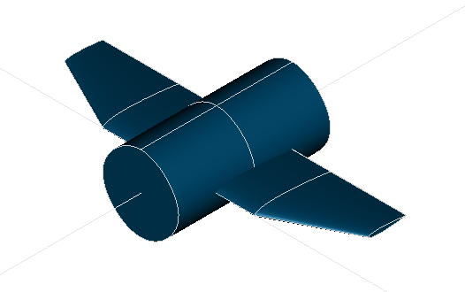
The tigl3.export module Example: Basic IGES Export
Write left and right wing + fuselage to test.iges:
import tigl3.exports exporter = tigl3.exports.create_exporter("igs") exporter.add_shape(wing.get_loft())
exporter.add_shape(wing.get_mirrored_loft())
exporter.add_shape(fuselage.get_loft()) exporter.write("test.igs")

Slide 22
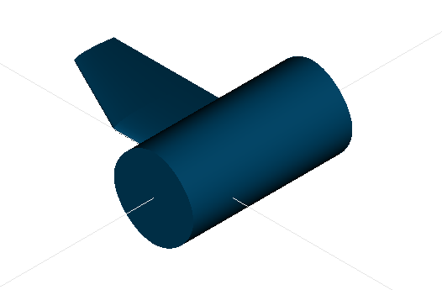
The tigl3.export module Example: IGES Export with layers
The IGES file format supports layers that are used e.g. by mesh generators
Write fuselage and wing to separate layers 1111 and 2222:
import tigl3.exports exporter = tigl3.exports.create_exporter("igs")
exporter.add_shape(fuselage.get_loft(), tigl3.exports.IgesShapeOptions(1111)) exporter.add_shape(wing.get_loft(), tigl3.exports.IgesShapeOptions(2222)) exporter.write("test_layers.igs")
S0000001 ,,31HOpen CASCADE IGES processor 6.8,13HFilename.iges, G0000001 16HOpen CASCADE 6.8,31HOpen CASCADE IGES processor 6.8,32,308,15,308,15,G0000002 ,1.,2,2HMM,1,0.01,15H20180910.100150,0.000195405,2000.322906,4HTiGL, G0000003 33HGerman Aerospace Center (DLR), SC,11,0,15H20180910.100150,; G0000004 514 1 0 0 1111 0 0 000010000D0000001 514 0 0 1 1 F1 D0000002 510 2 0 0 1111 0 0 000010000D0000003 510 0 0 1 1 F1 D0000004 .
.
514 90 0 0 2222 0 0 000010000D0000079 514 0 0 1 1 W1 D0000080 510 91 0 0 2222 0 0 000010000D0000081 510 0 0 1 1 Bottom D0000082 128 92 0 0 0 0 0 000010000D0000083

Slide 23
The tigl3.export module Example: IGES Export of whole aircraft with custom settings
Now lets export the whole aircraft.
Lets tweak the default settings:
By default, the IGES export includes the far field and produces does not include symmetries
Lets change this
import tigl3.exports
# get the current IGES settings and modify them iges_config = tigl3.exports.get_export_config("igs") iges_config.set_include_farfield(False) iges_config.set_apply_symmetries(True)
# create the exporter with the new settings exporter = tigl3.exports.create_exporter("igs", iges_config) exporter.add_configuration(config) exporter.write("test.igs")

Slide 24
The tigl3.import_export_helper module Convenience layer
Wrap the exporters in simple to use functions
Currently only one function: export_shapes(shapes, filename, deflection=0.001)
Automatically determines exporter according to file extension
Can also use OCC.TopoDS.TopoDS_Shapes
Example:
from tigl3.import_export_helper import export_shapes
export_shapes([a_named_shape, a_topods_shape], "mystepfile.stp")

Slide 25
Practical Session
Now it‘s your turn
Goal: Get to know the new API. Look around. Play around.
Possible Tasks:
Install tigl3 via conda if not yet done
Open exercise 1 from course material inside a jupyter notebook
Load an aircraft configuration with TiXI and TiGL
Access the first wing
Check, which methods the CCPACSWing class offers
Print the wing UID
Get the shape of the wing
Display all face names of the wing
Rename the trailing edge of the wing
Create named shape with a box
Export wing and box to an IGES file with separate layers
Drop exported *.igs file into TiGL Viewer to check.
Open IGES file in text editor. What is in there?

Slide 26
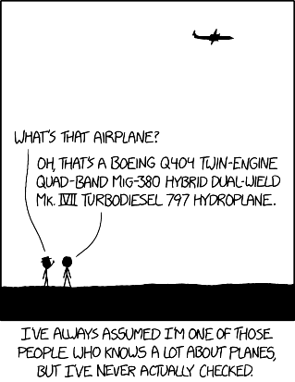
Any Questions?

